Slide 1
Lecture 4. Principal Component Analysis: Method and Model
Finding a hidden factor a-la Galton-Pearson
Matrix spectrum, singular value decomposition, data approximation
Principal components, loadings, contributions
Data summarization and matrix factorization: PCA and K-means
Notes:
Mention that it is based on a model; usually considered a purely heuristic, thus much attractive; yet the model may be perceived as overly simplistic (a few did and rejected it). I still think that telling the truth is better than hiding it.

Slide 2
Principal Component Analysis: Hidden Factor Model, 1
F. Galton: Set of students,
marks over
- Software Engineering,
- Object-Oriented Programming,
- Computational Intelligence
Can table help in deriving
hidden talent scores?
# | SEn OOP CI | Average
1 2 3 4 5 6 | 41 66 90 57 56 60 61 72 79 69 73 72 63 52 88 62 83 80 | 65.7 57.7 70.7 71.3 67.7 75.0
Why would one want anything better than the average?
_{Model}
Mark(St., Subj.)= Talent_Score(Stud.)∗Loading(Subj.)+Error
Type of Model: Observed=F(Hidden)+Error

Slide 3
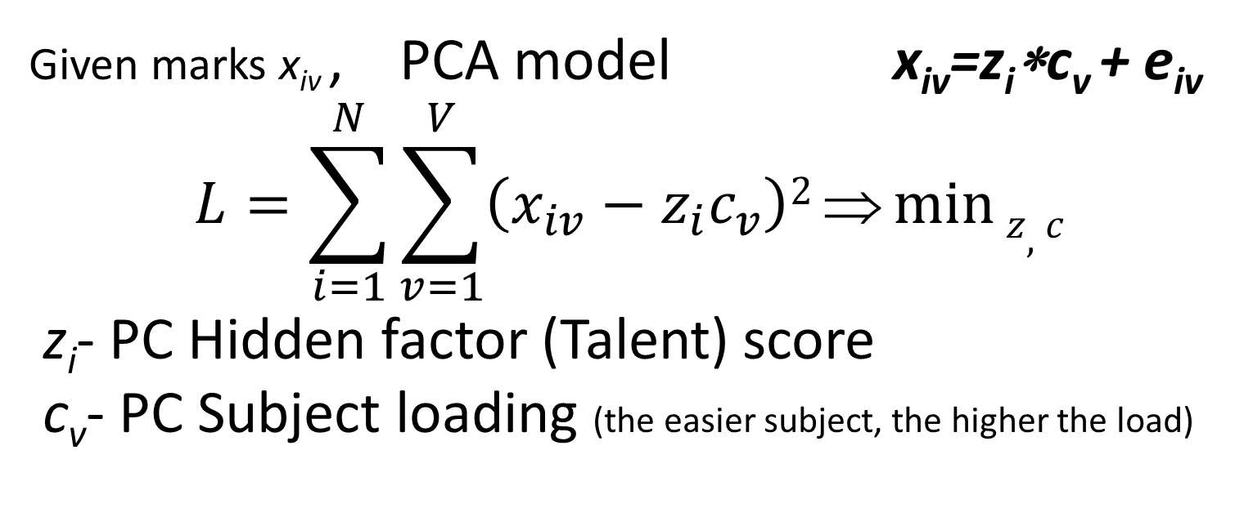
Principal Component Analysis: Hidden Factor Model, 2
# | SEn OOP CI | Average
1 2 3 4 5 6 | 41 66 90 57 56 60 61 72 79 69 73 72 63 52 88 62 83 80 | 65.7 57.7 70.7 71.3 67.7 75.0
Given marks x_{iv} , PCA model x_{iv}=z_{i}∗c_{v} + e_{iv}
$$L=\sum_{i=1}^{N}{\sum_{v=1}^{V}{\left(x_{iv}−z_{i}c_{v}\right)2}⇒\min{z,c}}$$
z_{i}- PC Hidden factor (Talent) score
c_{v}- PC Subject loading (the easier subject, the higher the load)

Slide 4
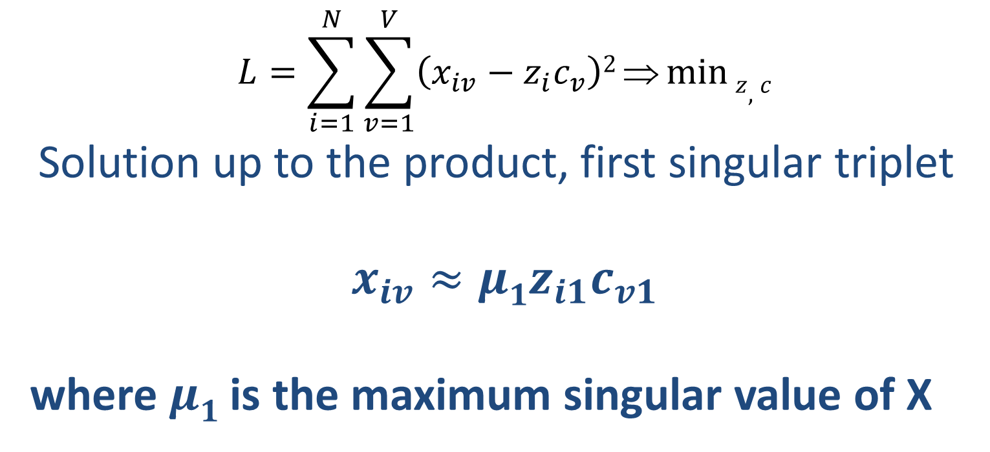
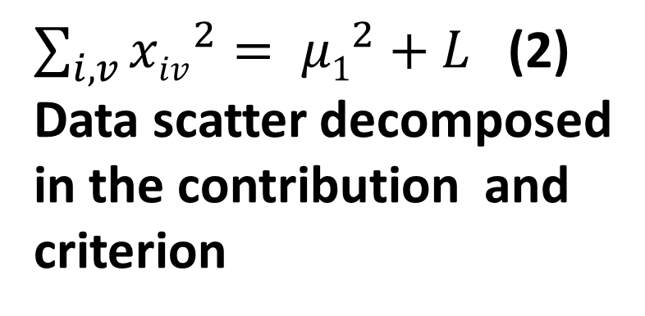
Principal Component Analysis: Hidden Factor Model, 3
# | SEn OOP CI | Average
1 2 3 4 5 6 | 41 66 90 57 56 60 61 72 79 69 73 72 63 52 88 62 83 80 | 65.7 57.7 70.7 71.3 67.7 75.0
$\sum_{i,v}{{xiv}_{}^{2}= {μ1}^{2}+L }$(2)
Data scatter decomposed
in the contribution and
criterion
$$L=\sum_{i=1}^{N}{\sum_{v=1}^{V}{\left(x_{iv}−z_{i}c_{v}\right)2}⇒\min{z,c}}$$
Solution up to the product, first singular triplet
$$x_{iv}≈{μ1z}_{i1}c_{v1}$$
where $μ1$ is the maximum singular value of X
(1)

Slide 5
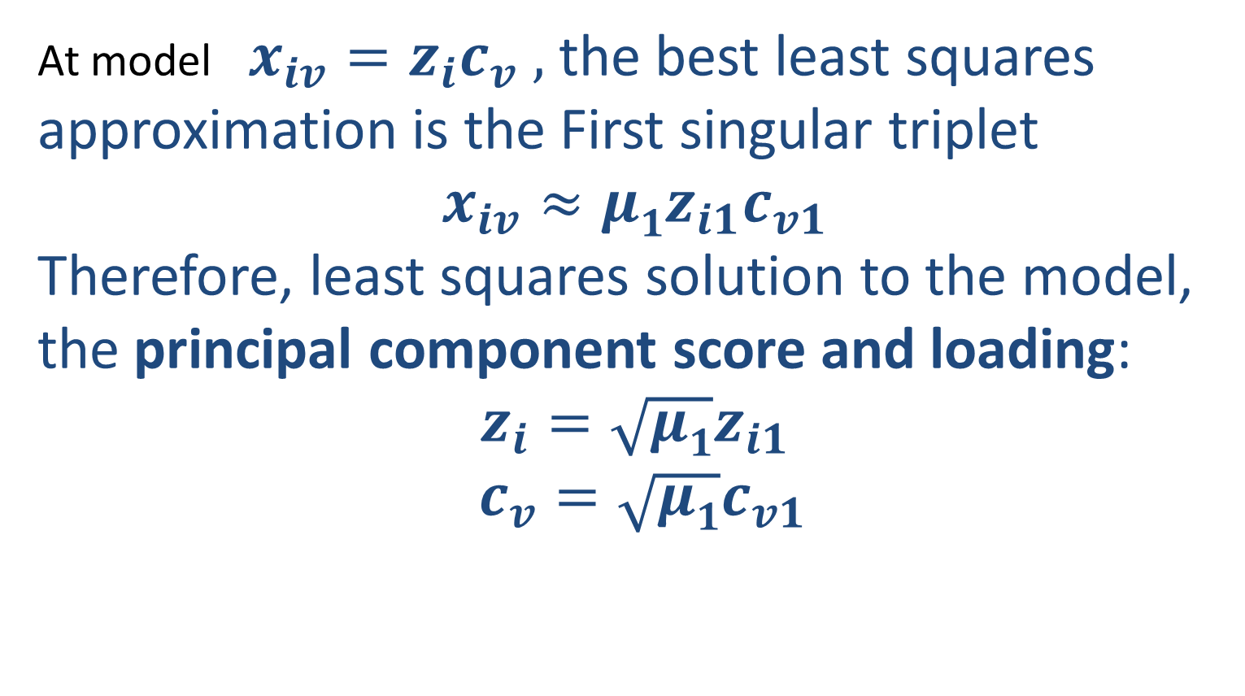
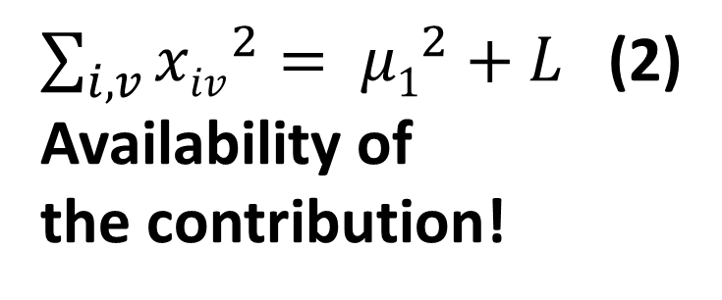
Principal Component Analysis: Hidden Factor Model, 4
# | SEn OOP CI | Average
1 2 3 4 5 6 | 41 66 90 57 56 60 61 72 79 69 73 72 63 52 88 62 83 80 | 65.7 57.7 70.7 71.3 67.7 75.0
$\sum_{i,v}{{xiv}_{}^{2}= {μ1}^{2}+L }$(2)
Availability of
the contribution!
At model $x_{iv}=z_{i}c_{v} ,$ the best least squares approximation is the First singular triplet
$$x_{iv}≈{μ1z}_{i1}c_{v1}$$
Therefore, least squares solution to the model, the principal component score and loading:
$$z_{i}=\sqrt{μ1}z_{i1}$$
$c_{v}=\sqrt{μ1}c_{v1}$
(1)

Slide 6
Principal Component Analysis: Hidden Factor Model, 5
* =
# | SEn OOP CI | Average
1 2 3 4 5 6 | 41 66 90 57 56 60 61 72 79 69 73 72 63 52 88 62 83 80 | 65.7 57.7 70.7 71.3 67.7 75.0
How from here to move to a 100 grade factor scale?
Residuals
41 66 90
57 56 60
61 72 79
69 73 72
63 52 88
62 83 80
6.85
5.83
7.21
7.20
6.95
7.64
-16.88 -0.29 12.93
7.78 -0.37 -5.53
0.12 2.28 -2.05
8.17 3.33 -9.00
4.31 -15.22 9.85
-2.53 9.09 -5.92
Loadings
=
8.45 9.67 11.25
+
Factor scores

Slide 7
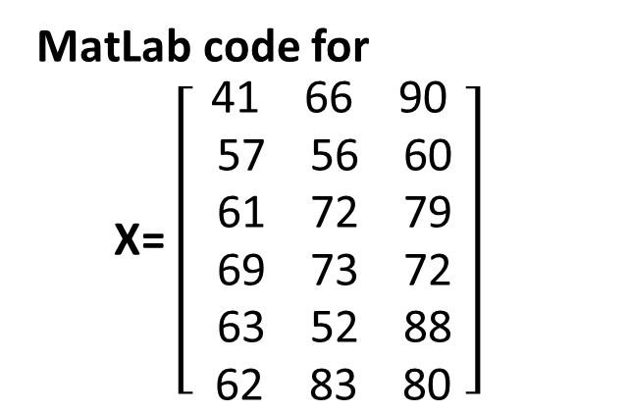
Principal Component Analysis: Hidden Factor Model, 6
* =
# | SEn OOP CI | Average
1 2 3 4 5 6 | 41 66 90 57 56 60 61 72 79 69 73 72 63 52 88 62 83 80 | 65.7 57.7 70.7 71.3 67.7 75.0
MatLab code for
X= $\left[\begin{aligned}\text{41 66 90} \\ \text{ 57 56 60} \\ \text{ 61 72 79} \\ \text{ 69 73 72} \\ \text{ 63 52 88} \\ \text{ 62 83 80} \end{aligned}\right]$
>> [Z,Mu,C]=svd(X); % unfortunately, MatLab’s output is
% excessive, thus:
>> Z=Z(:,1:3) % three singular 6D scoring vectors
>> Mu=Mu(1:3,:) % three singular values on diagonal

Slide 8

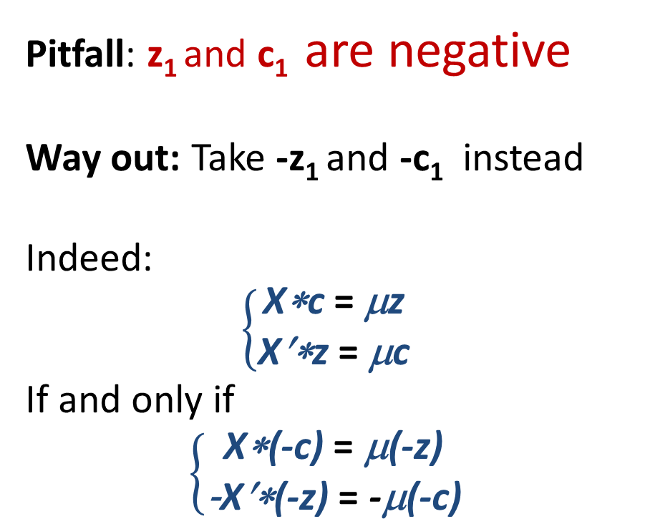
Principal Component Analysis: Hidden Factor Model, 7
X= $\left[\begin{aligned}\text{41 66 90} \\ \text{ 57 56 60} \\ \text{ 61 72 79} \\ \text{ 69 73 72} \\ \text{ 63 52 88} \\ \text{ 62 83 80} \end{aligned}\right]$
* =
>> [Z,Mu,C]=svd(X); % unfortunately, MatLab output is excessive
>> Z=Z(:,1:3) % three singular 6D scoring vectors
>> Mu=Mu(1:3,:) % three singular values on diagonal
Pitfall: z₁ and c₁ are negative
Way out: Take -z₁ and -c₁ instead
Indeed:
$$\left\{\begin{aligned}\text{X}\text{∗}\text{c} \text{= }\text{μ}\text{z} \\ \text{X}\text{′∗}\text{z} \text{= }\text{μ}\text{c}\end{aligned}\right.$$
If and only if
$$\left\{\begin{aligned}\text{X}\text{∗(−}\text{c}\text{)} \text{= }\text{μ}\text{(−}\text{z}\text{)} \\ \text{−}\text{X}\text{′∗(−}\text{z}\text{)} \text{= }\text{−}\text{μ}\text{(−}\text{c}\text{)}\end{aligned}\right.$$
First Second Third
-0.4015 -0.7139 -0.4033
-0.3414 0.3114 0.2075
Z= -0.4222 0.0859 -0.0948
-0.4219 0.4583 0.0582
-0.4071 -0.3594 0.7596
-0.4476 0.2166 -0.4528
μ= 291.39 27.37 20.84
-0.4948 0.5895 0.6385
C= -0.5667 0.3382 -0.7513
-0.6588 -0.7336 0.1667

Slide 9
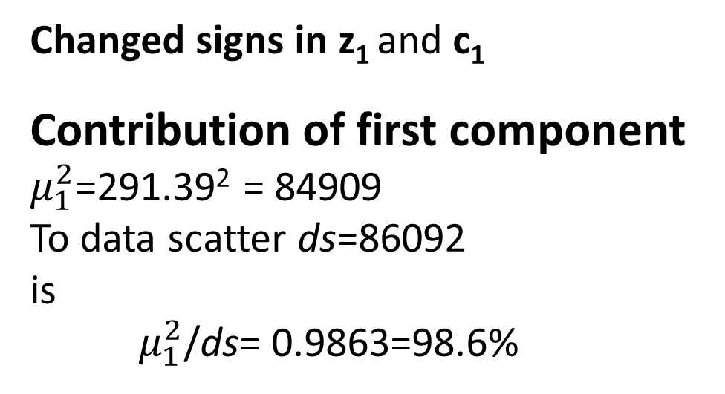
Principal Component Analysis: Hidden Factor Model, 8
X= $\left[\begin{aligned}\text{41 66 90} \\ \text{ 57 56 60} \\ \text{ 61 72 79} \\ \text{ 69 73 72} \\ \text{ 63 52 88} \\ \text{ 62 83 80} \end{aligned}\right]$
* =
>> [Z,Mu,C]=svd(X); % unfortunately, MatLab output is excessive
>> Z=Z(:,1:3) % three singular 6D scoring vectors
>> Mu=Mu(1:3,:) % three singular values on diagonal
>>ds=sum(sum(X.*X)) % data scatter
First Second Third
0.4015 -0.7139 -0.4033
0.3414 0.3114 0.2075
Z= 0.4222 0.0859 -0.0948
0.4219 0.4583 0.0582
0.4071 -0.3594 0.7596
0.4476 0.2166 -0.4528
μ= 291.39 27.37 20.84
0.4948 0.5895 0.6385
C= 0.5667 0.3382 -0.7513
0.6588 -0.7336 0.1667
Changed signs in z₁ and c₁
Contribution of first component
$μ_{1}^{2}$=291.39² = 84909
To data scatter ds=86092
is
$μ_{1}^{2}$/ds= 0.9863=98.6%

Slide 10

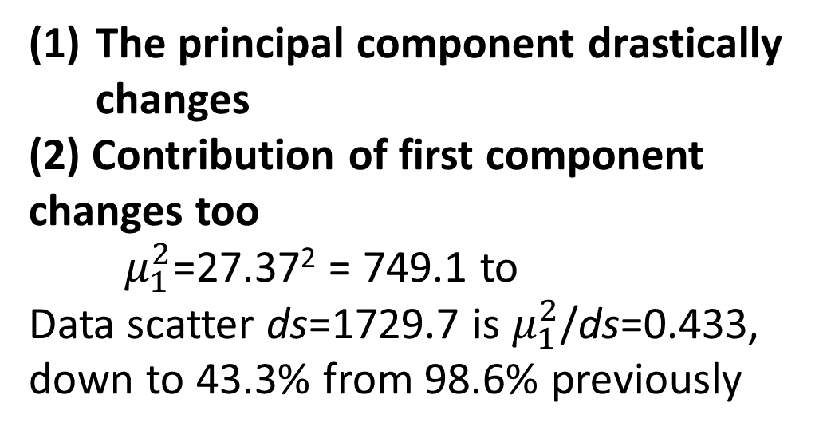
Principal Component Analysis: Hidden Factor Model, 9
Y= $\left[\begin{aligned}−17.83 −1.00 11.83 \\ −1.83 −11.00 −18.17 \\ 2.17 5.00 0.83 \\ 10.17 6.00 −6.17 \\ 4.17 −15.00 9.83 \\ 3.17 16.00 1.83\end{aligned}\right]$
* =
What happens if data is preprocessed by centering, subtracting the column means
from the columns?
>>Y=X-repmat(mean(X),6,1); % centering
>> [Z,Mu,C]=svd(Y);
First Second Third
-0.7086 0.1783 0.4534
0.2836 -0.6934 0.4706
0.0935 0.1841 -0.0486
Z= 0.4629 0.0931 -0.1916
-0.3705 -0.3374 -0.7293
0.2391 0.5753 0.0455
μ= 27.37 26.13 17.26
0.5933 -0.0056 -0.8049
C= 0.3734 0.8878 0.2690
-0.7131 0.4601 -0.5289
The principal component drastically changes
(2) Contribution of first component
changes too
$μ_{1}^{2}$=27.37² = 749.1 to
Data scatter ds=1729.7 is $μ_{1}^{2}$/ds=0.433,
down to 43.3% from 98.6% previously

Slide 11
Principal Component Analysis: Hidden Factor Model, 10
* =
Why such a drastic change? after the data X is preprocessed into Y by centering, that is, subtracting the column means from the columns
Contribution down to 43.3% from 98.6%, etc.
Red dots – raw data X
Blue – data Y centered
Circle – space origin
Red arrow – PC for X
Blue arrow – PC for Y
Why? Because all PCs must go through the origin.
Just compare the lengths of red and blue vectors.

Slide 12
Principal Component Analysis Hidden Factor Model, 11
* =
PCA methodology: Summary
Principal component is a rescaled singular triplet
Principal components optimally approximate the data according to the least squares criterion
Principal components are orthogonal to each other
Principal component’s contribution is proportional to its squared singular value
Principal components change at any data transformation, centering included
Principal components of X are highly related to eigenvalues and eigenvectors of A=X′X

Slide 13
Principal Component Analysis: Method and Model
Summary
Theoretic introduction: Summarization versus Correlation: Summarization is similar to correlation if all features are considered target; the data standardization issue is important yet to be explored.
Matrix operations: Be cautious, matrices are not numbers!
Matrix spectrum, singular value decomposition, approximation: Considering a square matrix as a mapping, eigenvectors represent axes that are mapped onto themselves. For symmetric matrices these axes are mutually orthogonal. A rectangular matrix can be treated similarly if both direct and inverse mapping are considered. Luckily this amounts to multiplication of matrices and using one more, semi positive definite, property.
Notes:
Mention that it is based on a model; usually considered a purely heuristic, thus much attractive; yet the model may be perceived as overly simplistic (a few did and rejected it). I still think that telling the truth is better than hiding it.

Slide 14
Principal Component Analysis: Method and Model
Summary
Hidden factor model. Its solution. Principal components, loadings, contributions. This all comes from the SVD theory because of somewhat over simplistic character of the model, just a product of row-related item and a column-related item.
Notes:
Mention that it is based on a model; usually considered a purely heuristic, thus much attractive; yet the model may be perceived as overly simplistic (a few did and rejected it). I still think that telling the truth is better than hiding it.

Slide 15
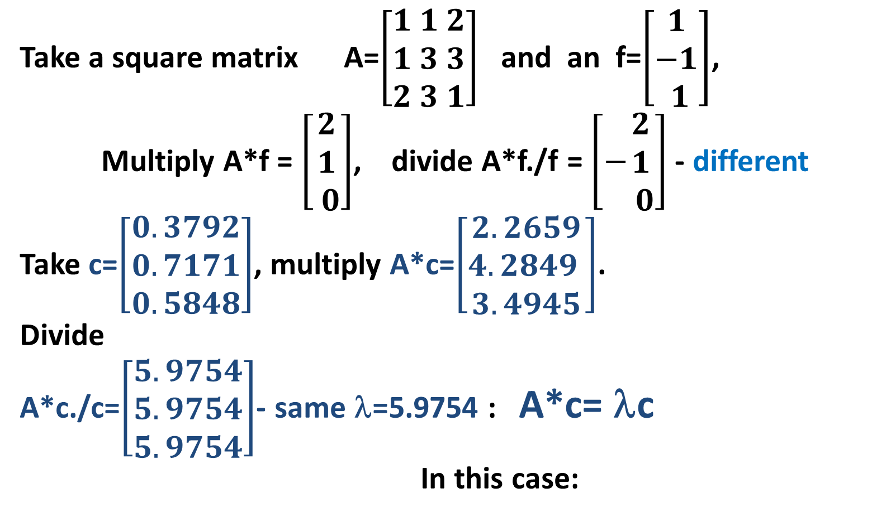
Principal Component Analysis 3: Spectrum, 1
Take a square matrix A=$\left[\begin{aligned}1 1 2 \\ 1 3 3 \\ 2 3 1\end{aligned}\right]$ and an f=$\left[\begin{aligned}1 \\ −1 \\ 1\end{aligned}\right]$,
Multiply A*f = $\left[\begin{aligned}2 \\ 1 \\ 0\end{aligned}\right]$, divide A*f./f = $\left[−\begin{aligned}2 \\ 1 \\ 0\end{aligned}\right]$ - different
Take c=$\left[\begin{aligned}0.3792 \\ 0.7171 \\ 0.5848\end{aligned}\right]$, multiply A*c=$\left[\begin{aligned}2.2659 \\ 4.2849 \\ 3.4945\end{aligned}\right]$.
Divide
A*c./c=$\left[\begin{aligned}5.9754 \\ 5.9754 \\ 5.9754\end{aligned}\right]$- same λ=5.9754 : A*c= λc
In this case:
values
c eigenvector
λ eigenvalue

Slide 16
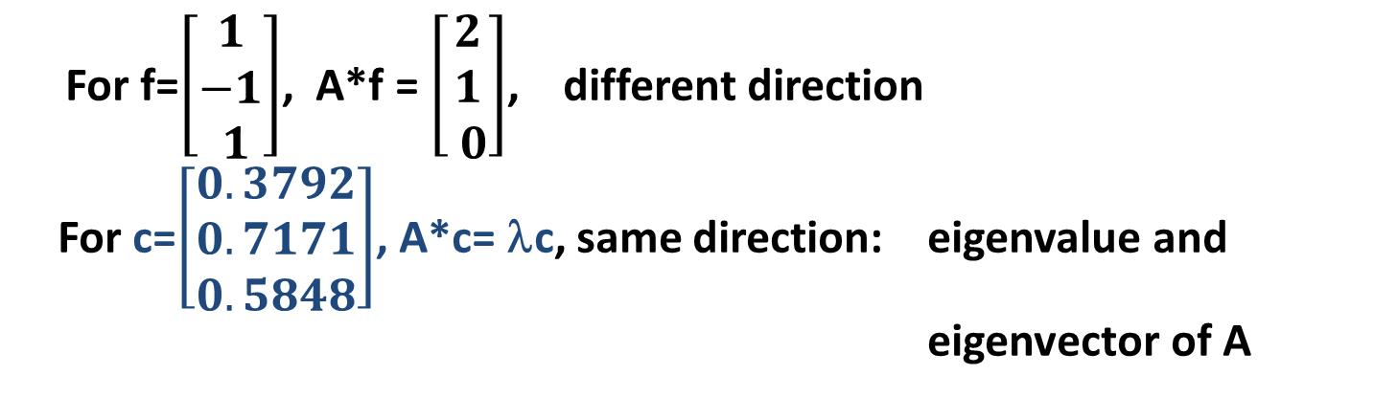
Principal Component Analysis 3: Spectrum, 2
For f=$\left[\begin{aligned}1 \\ −1 \\ 1\end{aligned}\right]$, A*f = $\left[\begin{aligned}2 \\ 1 \\ 0\end{aligned}\right]$, different direction
For c=$\left[\begin{aligned}0.3792 \\ 0.7171 \\ 0.5848\end{aligned}\right]$, A*c= λc, same direction: eigenvalue and
eigenvector of A
Grey f jumps
to green A*f
Blue c remains on the blue: eigenaxis of A

Slide 17
Principal Component Analysis 3: Spectrum, 3
Eigenvalues and eigenvectors: A*c= λc
If c is eigenvector for A, then so is αc for any real α; to make c unique, conventionally c is considered normed, |c|=1.
The number of different eigenvalues for an m×m A is not greater than m; the number of nonzero eigenvalues is A’s rank.
If A is symmetric, then all its eigenvalues are real; and the eigenvectors, mutually orthogonal (what does this mean?).

Slide 18
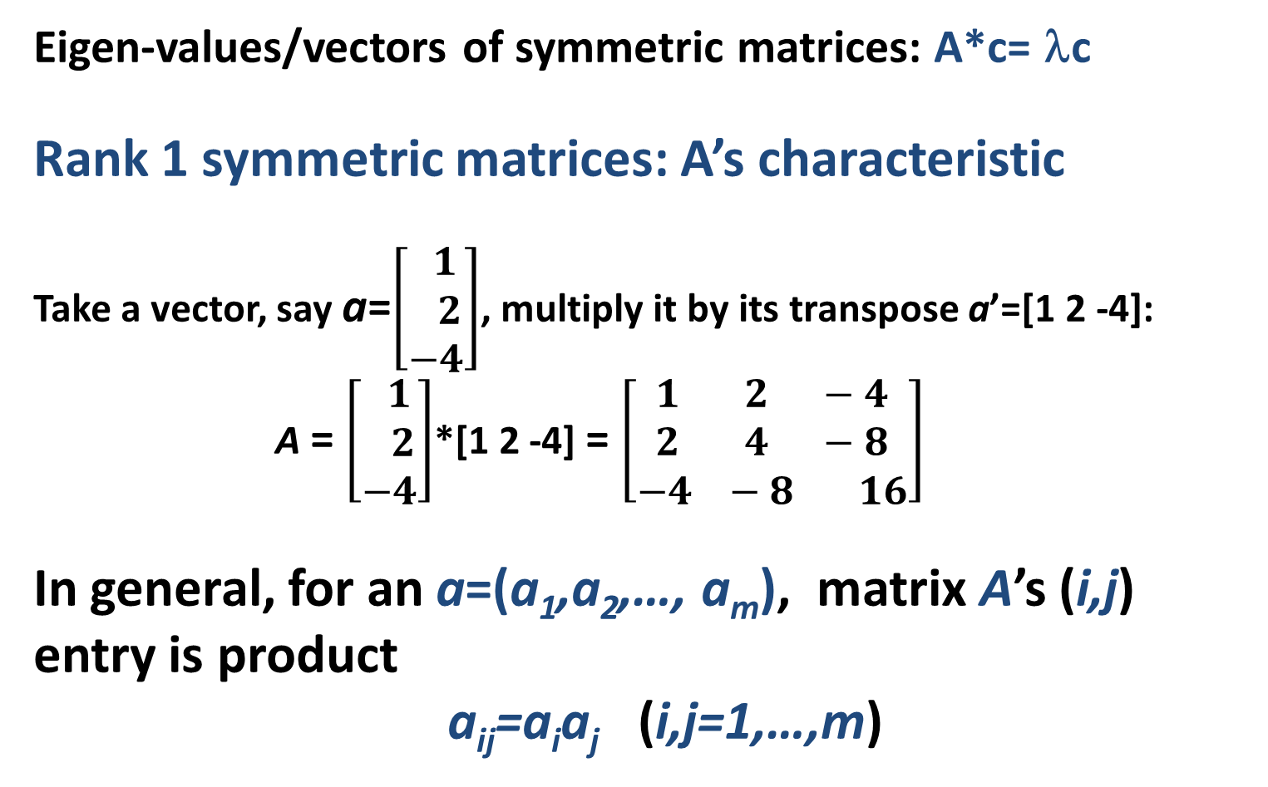
Principal Component Analysis 3: Spectrum, 4
Eigen-values/vectors of symmetric matrices: A*c= λc
Rank 1 symmetric matrices: A’s characteristic
Take a vector, say a=$\left[\begin{aligned} 1 \\ 2 \\ −4\end{aligned}\right]$, multiply it by its transpose a’=[1 2 -4]:
A = $\left[\begin{aligned} 1 \\ 2 \\ −4\end{aligned}\right]$*[1 2 -4] = $\left[\begin{aligned}1 2 −4 \\ 2 4 −8 \\ −4 −8 16\end{aligned}\right]$
In general, for an a=(a₁,a₂,…, a_{m}), matrix A’s (i,j) entry is product
a_{ij}=a_{i}a_{j} (i,j=1,…,m)

Slide 19
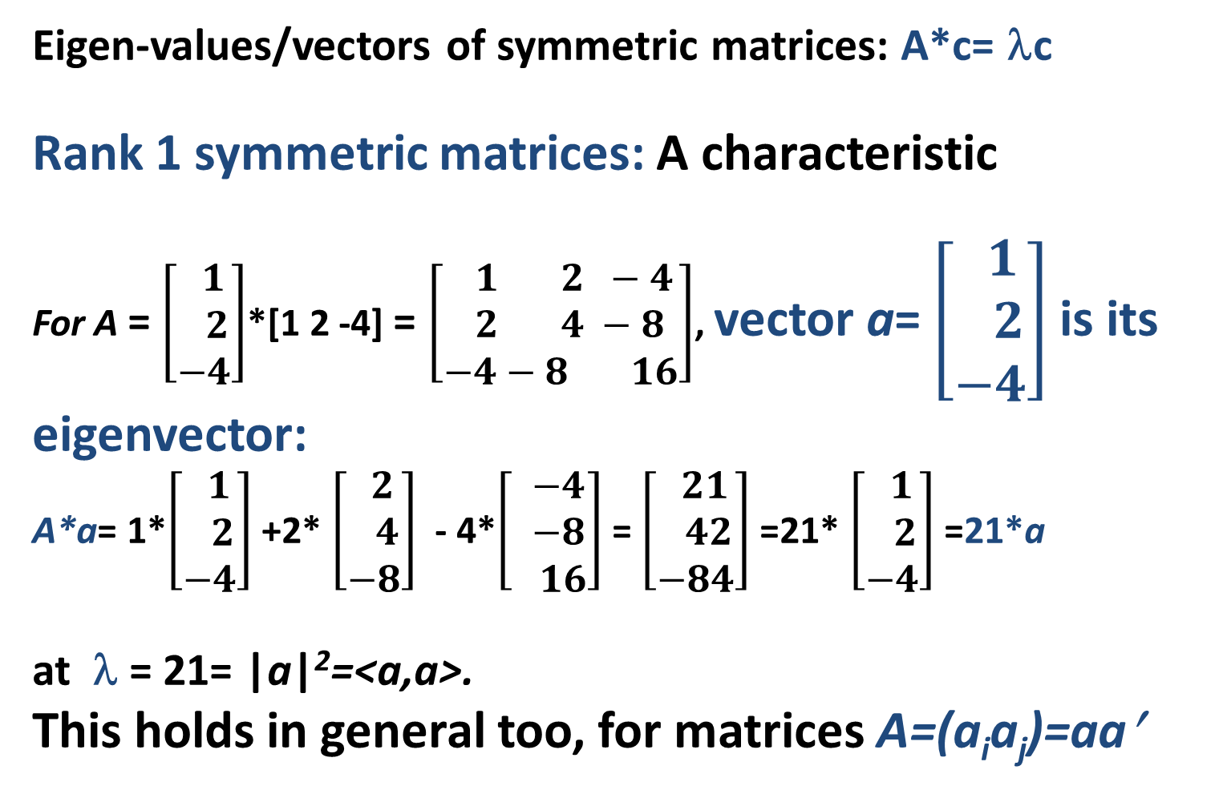
Principal Component Analysis 3: Spectrum, 5
Eigen-values/vectors of symmetric matrices: A*c= λc
Rank 1 symmetric matrices: A characteristic
For A = $\left[\begin{aligned} 1 \\ 2 \\ −4\end{aligned}\right]$*[1 2 -4] = $\left[\begin{aligned} 1 2 −4 \\ 2 4 −8 \\ −4−8 16\end{aligned}\right]$, vector a= $\left[\begin{aligned} 1 \\ 2 \\ −4\end{aligned}\right]$ is its eigenvector:
A*a= 1*$\left[\begin{aligned} 1 \\ 2 \\ −4\end{aligned}\right]$ +2* $\left[\begin{aligned} 2 \\ 4 \\ −8\end{aligned}\right]$ - 4*$\left[\begin{aligned} −4 \\ −8 \\ 16\end{aligned}\right]$ = $\left[\begin{aligned} 21 \\ 42 \\ −84\end{aligned}\right]$ =21* $\left[\begin{aligned} 1 \\ 2 \\ −4\end{aligned}\right]$ =21*a
at λ = 21= |a|²=<a,a>.
This holds in general too, for matrices A=(a_{i}a_{j})=aa′

Slide 20
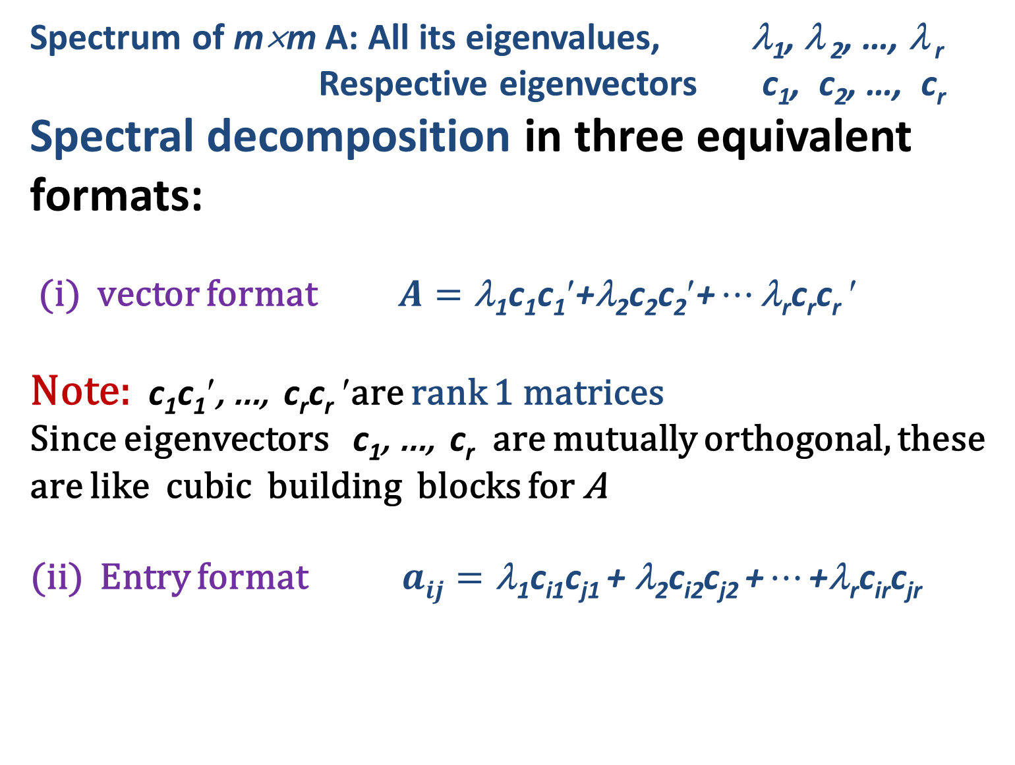
Principal Component Analysis 3: Spectrum, 6
Spectrum of m×m A: All its eigenvalues, λ₁, λ ₂, …, λ _{r}
Respective eigenvectors c₁, c₂, …, c_{r}
Spectral decomposition in three equivalent formats:
(i) vector format $A=\text{λ}\text{1}\text{c}\text{1}\text{c}\text{1}′\text{+}\text{λ}\text{2}\text{c}\text{2}\text{c}\text{2}′\text{+}…\text{λ}\text{r}\text{c}\text{r}\text{c}\text{r}$ $$
Note: $\text{c}\text{1}\text{c}\text{1}′$, …, $\text{c}\text{r}\text{c}\text{r}$ $$are rank 1 matrices
Since eigenvectors $\text{c}\text{1}$, …, $\text{c}\text{r}$ are mutually orthogonal, these are like cubic building blocks for A
(ii) Entry format $aij=\text{λ}\text{1}\text{c}\text{i}\text{1}\text{c}\text{j}\text{1 + λ2}\text{c}\text{i}\text{2}\text{c}\text{j}\text{2 +}…\text{+λ}\text{r}\text{c}\text{ir}\text{c}\text{jr}$

Slide 21
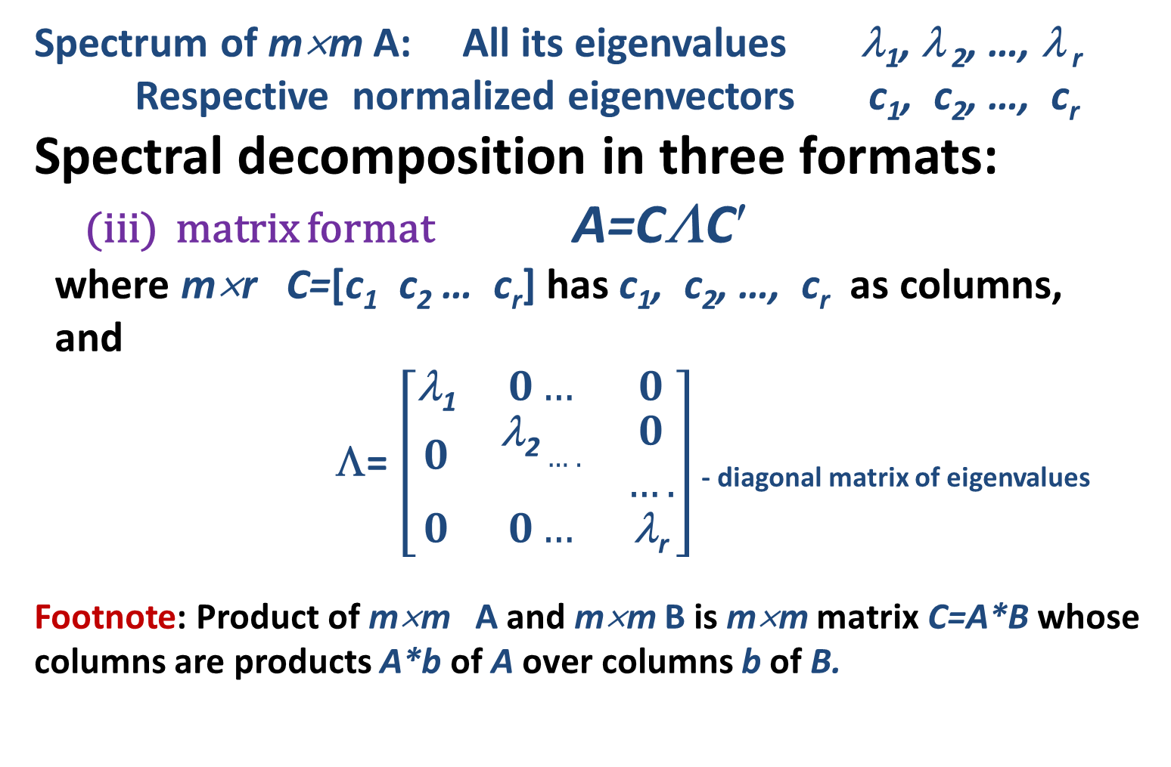
Principal Component Analysis 3: Spectrum, 7
Spectrum of m×m A: All its eigenvalues λ₁, λ ₂, …, λ _{r}
Respective normalized eigenvectors c₁, c₂, …, c_{r}
Spectral decomposition in three formats:
(iii) matrix format A=CΛC$$
where m×r C=[c₁ c₂ … c_{r}] has c₁, c₂, …, c_{r} as columns,
and
Λ= $\left[\begin{aligned}\begin{matrix}\text{}\text{1} & 0… & 0 \\ 0 & \begin{aligned}\text{}\text{2}…. \\ \end{aligned} & \begin{aligned}0 \\ ….\end{aligned} \\ 0 & 0… & \text{λ}\text{r}\end{matrix} \\ \end{aligned}\right]$ - diagonal matrix of eigenvalues
Footnote: Product of m×m A and m×m B is m×m matrix C=A*B whose columns are products A*b of A over columns b of B.

Slide 22
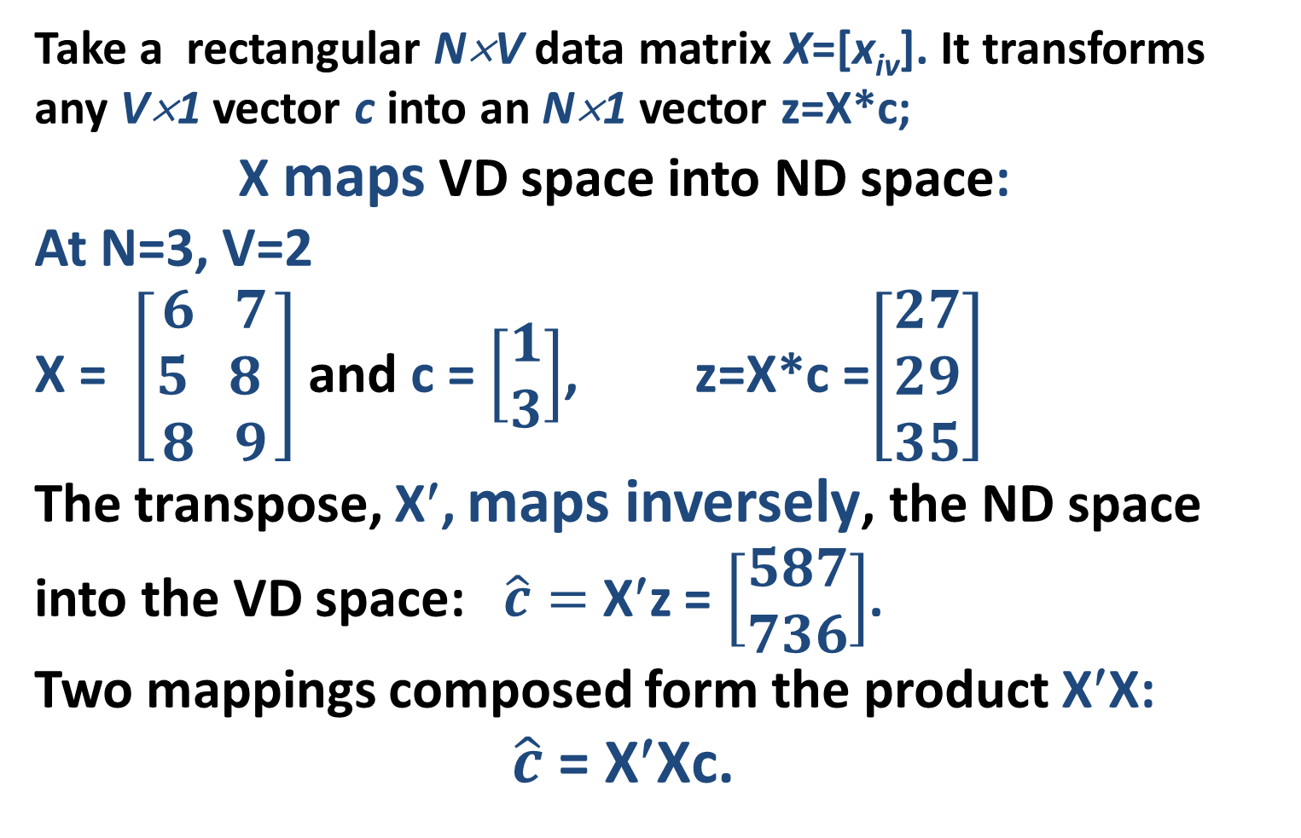
Principal Component Analysis 3: Singular value decomposition, 1 Composition
Take a rectangular N×V data matrix X=[x_{iv}]. It transforms any V×1 vector c into an N×1 vector z=X*c;
X maps VD space into ND space:
At N=3, V=2
X = $\left[\begin{aligned}6 7 \\ 5 8 \\ 8 9\end{aligned}\right]$ and c = $\left[\begin{aligned}1 \\ 3\end{aligned}\right]$, z=X*c =$\left[\begin{aligned}27 \\ 29 \\ 35\end{aligned}\right]$
The transpose, X′, maps inversely, the ND space into the VD space: $\hat{c}=$ X′z = $\left[\begin{aligned}587 \\ 736\end{aligned}\right]$.
Two mappings composed form the product X′X:
$\hat{c}$ = X′Xc.

Slide 23
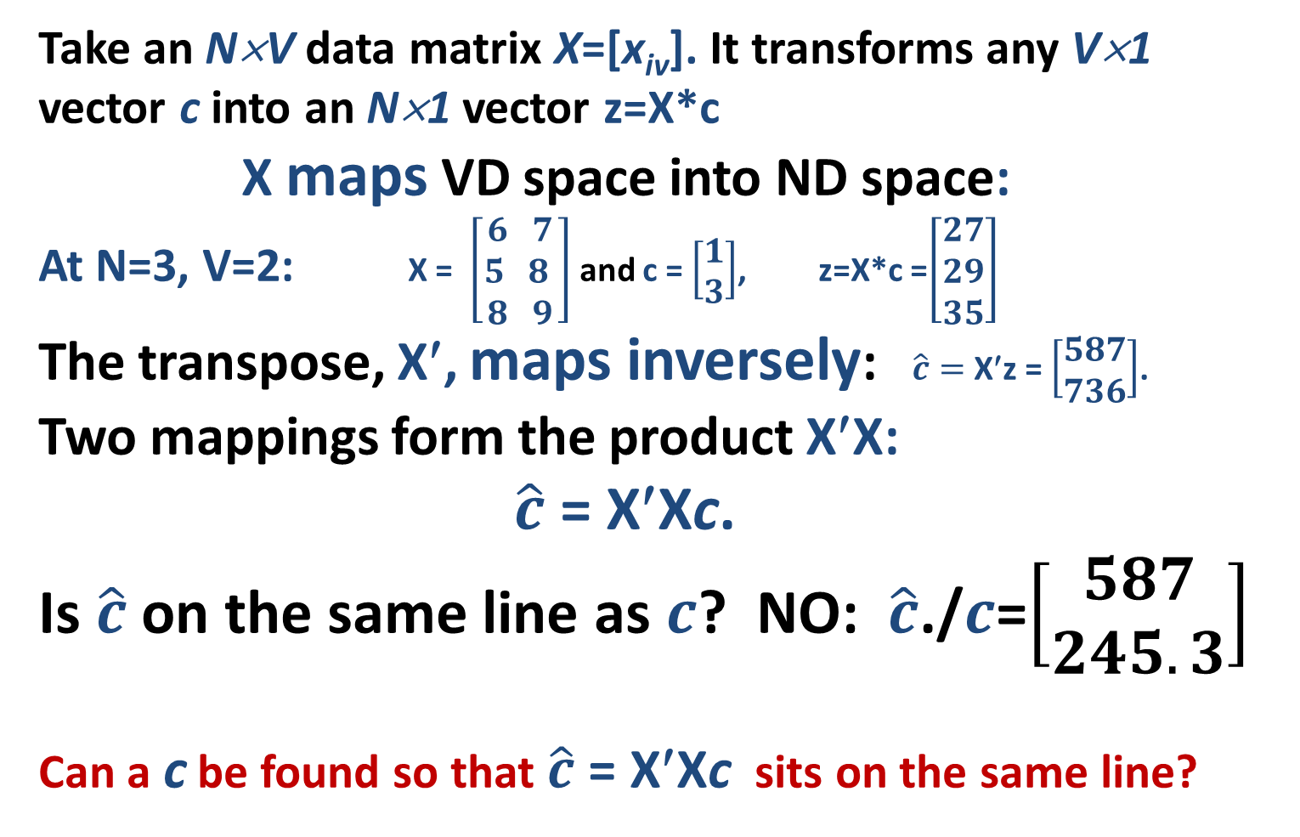
Principal Component Analysis 3: Singular value decomposition, 2 Composition
Take an N×V data matrix X=[x_{iv}]. It transforms any V×1 vector c into an N×1 vector z=X*c
X maps VD space into ND space:
At N=3, V=2: X = $\left[\begin{aligned}6 7 \\ 5 8 \\ 8 9\end{aligned}\right]$ and c = $\left[\begin{aligned}1 \\ 3\end{aligned}\right]$, z=X*c =$\left[\begin{aligned}27 \\ 29 \\ 35\end{aligned}\right]$
The transpose, X′, maps inversely: $\hat{c}=$ X′z = $\left[\begin{aligned}587 \\ 736\end{aligned}\right]$.
Two mappings form the product X′X:
$\hat{c}$ = X′Xc.
Is $\hat{c}$on the same line as $c$? NO: $\hat{c}$./$c$=$\left[\begin{aligned}587 \\ 245.3\end{aligned}\right]$
Can a c be found so that $\hat{c}$ = X′Xc sits on the same line?

Slide 24
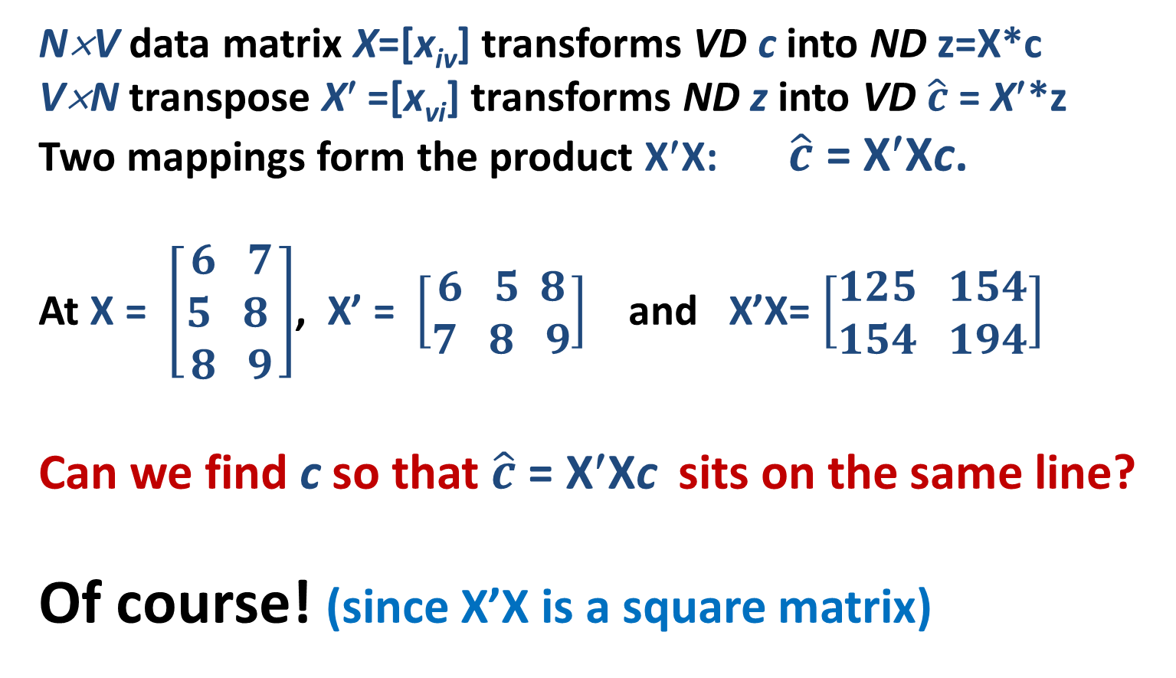
Principal Component Analysis 3: Singular value decomposition, 3 Composition
N×V data matrix X=[x_{iv}] transforms VD c into ND z=X*c
V×N transpose X′ =[x_{vi}] transforms ND z into VD $\hat{c}$= X′*z
Two mappings form the product X′X: $\hat{c}$ = X′Xc.
At X = $\left[\begin{aligned}6 7 \\ 5 8 \\ 8 9\end{aligned}\right]$, X’ = $\left[\begin{aligned}6 5 8 \\ 7 8 9\end{aligned}\right]$ and X’X= $\left[\begin{aligned}125 154 \\ 154 194\end{aligned}\right]$
Can we find c so that $\hat{c}$ = X′Xc sits on the same line?
Of course! (since X’X is a square matrix)

Slide 25
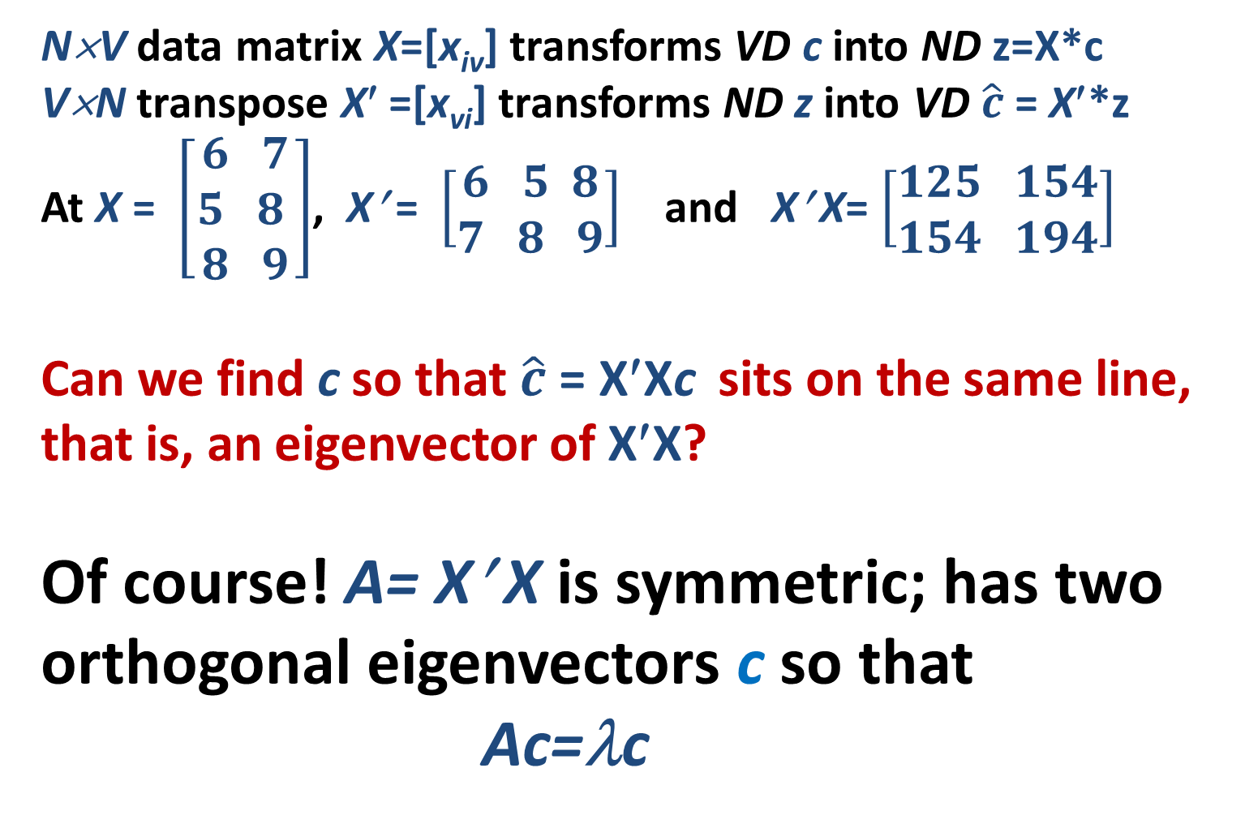
Principal Component Analysis 3: Singular value decomposition, 4 Composition
N×V data matrix X=[x_{iv}] transforms VD c into ND z=X*c
V×N transpose X′ =[x_{vi}] transforms ND z into VD $\hat{c}$= X′*z
At X = $\left[\begin{aligned}6 7 \\ 5 8 \\ 8 9\end{aligned}\right]$, X′ = $\left[\begin{aligned}6 5 8 \\ 7 8 9\end{aligned}\right]$ and X′ X= $\left[\begin{aligned}125 154 \\ 154 194\end{aligned}\right]$
Can we find c so that $\hat{c}$ = X′Xc sits on the same line, that is, an eigenvector of X′X?
Of course! A= X′ X is symmetric; has two orthogonal eigenvectors c so that
Ac=λc

Slide 26
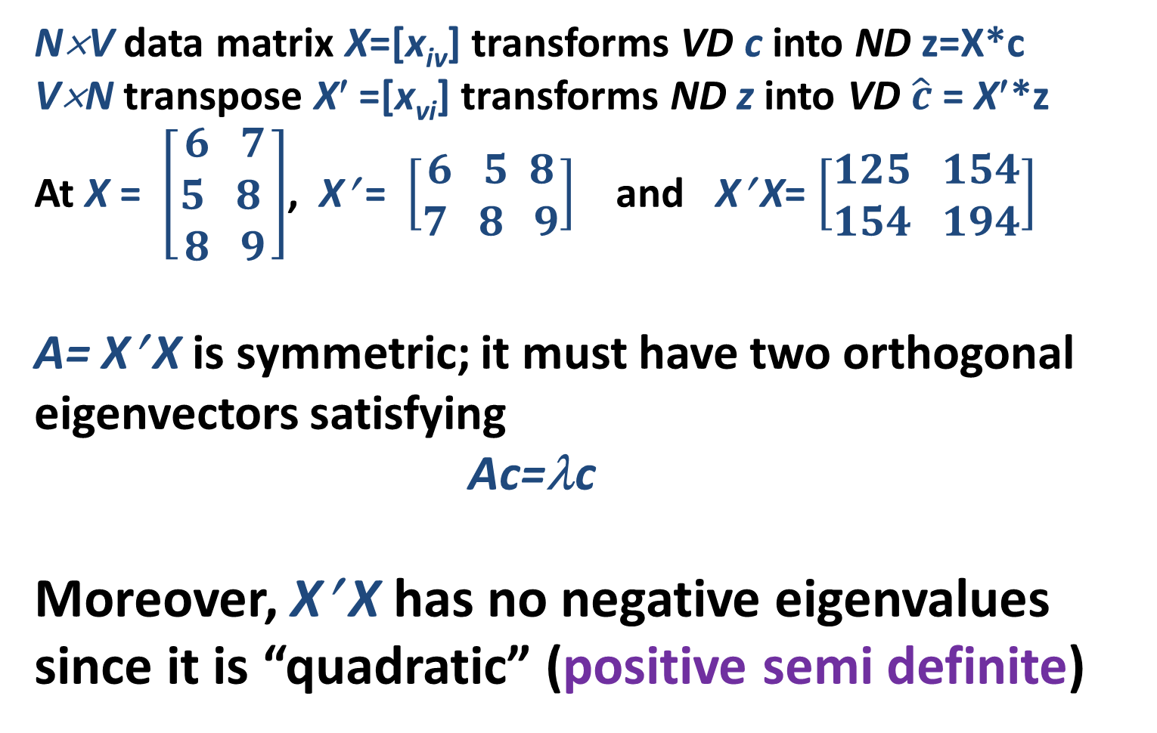
Principal Component Analysis 3: Singular value decomposition, 5 Composition
N×V data matrix X=[x_{iv}] transforms VD c into ND z=X*c
V×N transpose X′ =[x_{vi}] transforms ND z into VD $\hat{c}$= X′*z
At X = $\left[\begin{aligned}6 7 \\ 5 8 \\ 8 9\end{aligned}\right]$, X′ = $\left[\begin{aligned}6 5 8 \\ 7 8 9\end{aligned}\right]$ and X′ X= $\left[\begin{aligned}125 154 \\ 154 194\end{aligned}\right]$
A= X′ X is symmetric; it must have two orthogonal eigenvectors satisfying
Ac=λc
Moreover, X′ X has no negative eigenvalues since it is “quadratic” (positive semi definite)

Slide 27
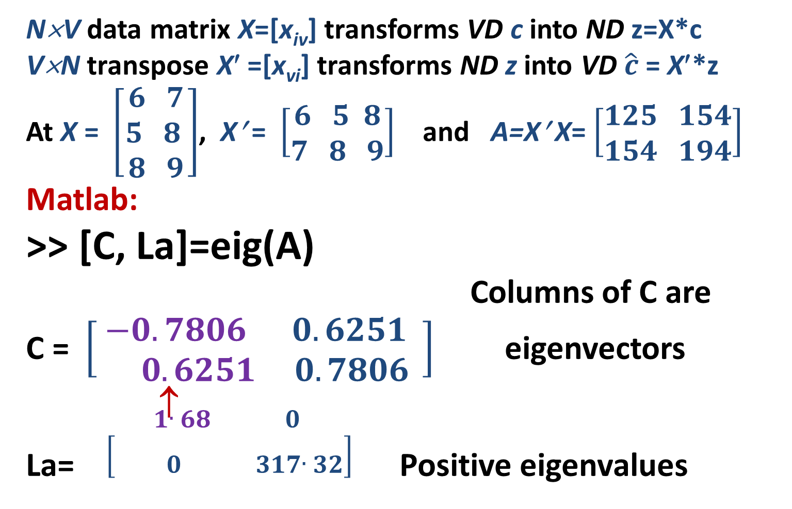
Principal Component Analysis 3: Singular value decomposition, 6 Composition
N×V data matrix X=[x_{iv}] transforms VD c into ND z=X*c
V×N transpose X′ =[x_{vi}] transforms ND z into VD $\hat{c}$= X′*z
At X = $\left[\begin{aligned}6 7 \\ 5 8 \\ 8 9\end{aligned}\right]$, X′ = $\left[\begin{aligned}6 5 8 \\ 7 8 9\end{aligned}\right]$ and A=X′ X= $\left[\begin{aligned}125 154 \\ 154 194\end{aligned}\right]$
Matlab:
>> [C, La]=eig(A)
Columns of C are
C = $\left[\begin{aligned} −0.7806 0.6251 \\ 0.6251 0.7806\end{aligned}\right]$ eigenvectors
↑
La= $\left[\begin{aligned}1.68 0 \\ 0 317.32\end{aligned}\right]$ Positive eigenvalues

Slide 28
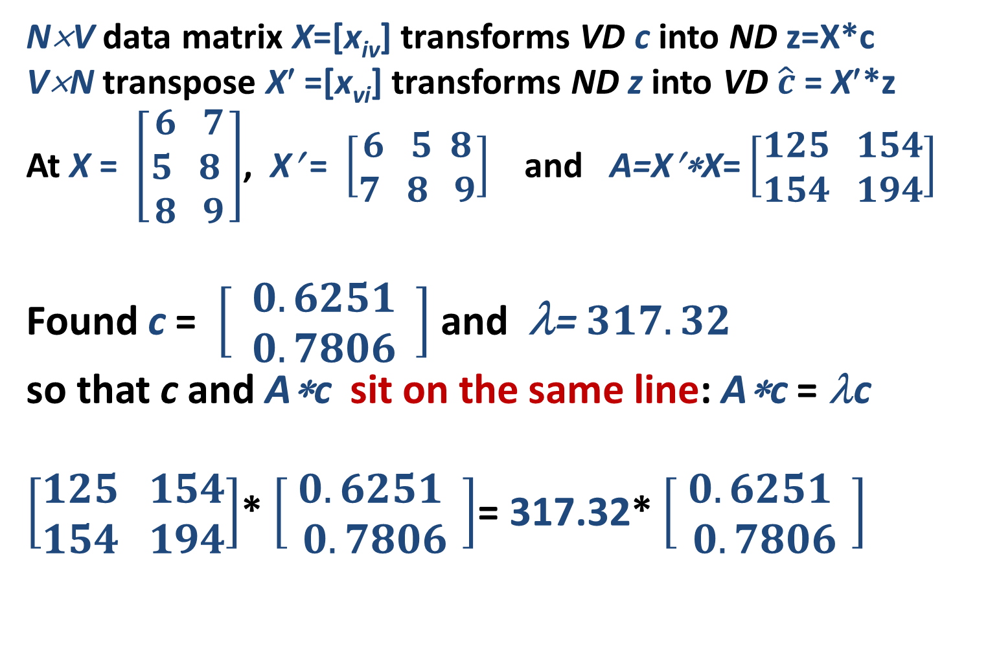
Principal Component Analysis 3: Singular value decomposition, 7 Composition
N×V data matrix X=[x_{iv}] transforms VD c into ND z=X*c
V×N transpose X′ =[x_{vi}] transforms ND z into VD $\hat{c}$= X′*z
At X = $\left[\begin{aligned}6 7 \\ 5 8 \\ 8 9\end{aligned}\right]$, X′ = $\left[\begin{aligned}6 5 8 \\ 7 8 9\end{aligned}\right]$ and A=X′∗X= $\left[\begin{aligned}125 154 \\ 154 194\end{aligned}\right]$
Found c = $\left[\begin{aligned} 0.6251 \\ 0.7806\end{aligned}\right]$ and λ= $317.32$
so that c and A∗c sit on the same line: A∗c = λc
$\left[\begin{aligned}125 154 \\ 154 194\end{aligned}\right]$* $\left[\begin{aligned} 0.6251 \\ 0.7806\end{aligned}\right]$= 317.32* $\left[\begin{aligned} 0.6251 \\ 0.7806\end{aligned}\right]$

Slide 29
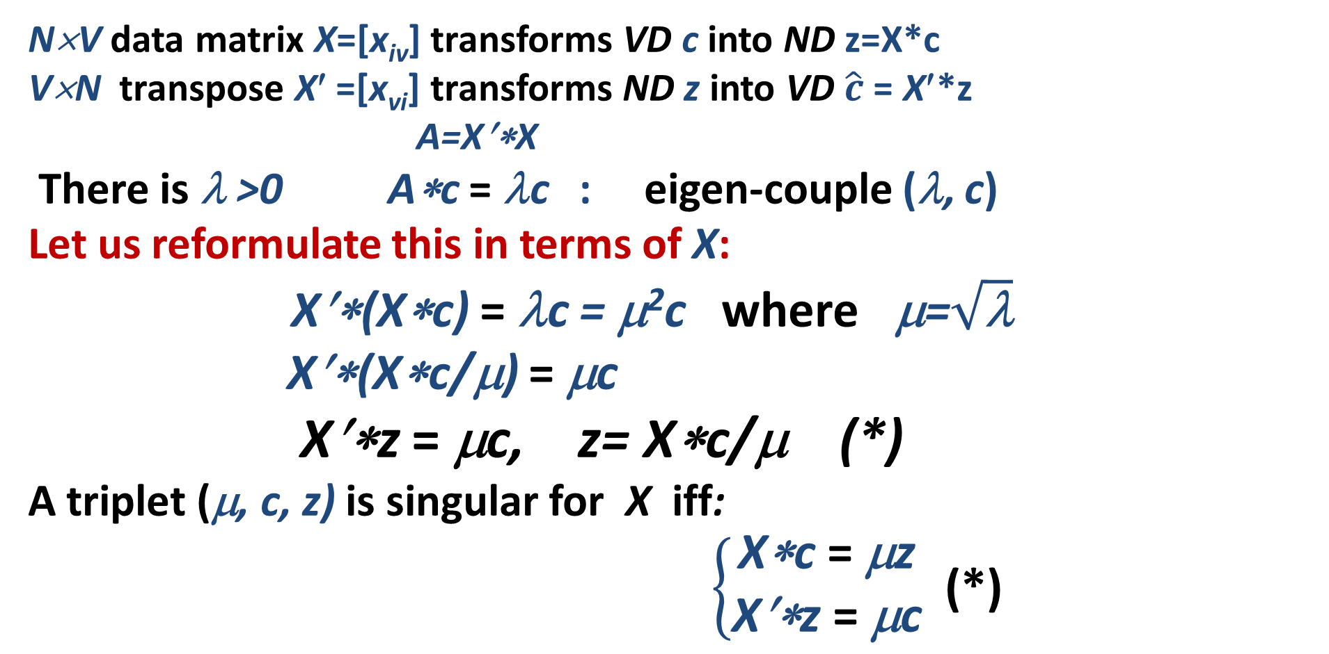
Principal Component Analysis 3: Singular value decomposition, 1 Singular triplet
N×V data matrix X=[x_{iv}] transforms VD c into ND z=X*c
V×N transpose X′ =[x_{vi}] transforms ND z into VD $\hat{c}$= X′*z
A=X′∗X
There is λ >0 A∗c = λc : eigen-couple (λ, c)
Let us reformulate this in terms of X:
X′∗(X∗c) = λc = μ²c where μ=$\sqrt{\text{λ}}$
X′∗(X∗c/μ) = μc
X′∗z = μc, z= X∗c/μ (*)
A triplet (μ, c, z) is singular for X iff:
$\left\{\begin{aligned}\text{X}\text{∗}\text{c} \text{= }\text{μ}\text{z} \\ \text{X}\text{′∗}\text{z} \text{= }\text{μ}\text{c}\end{aligned}\right.$ (*)

Slide 30
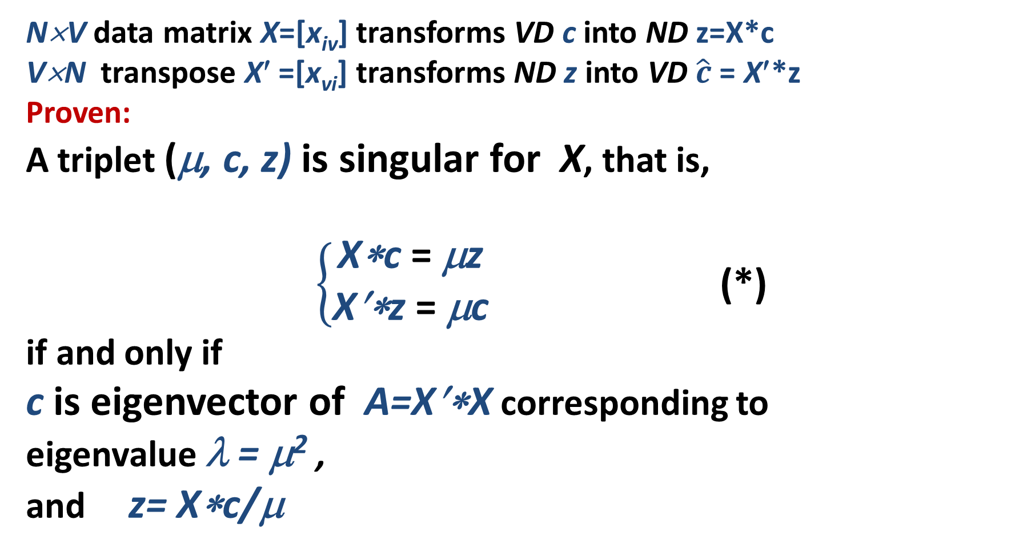
Principal Component Analysis 3: Singular value decomposition, 2 Singular triplet
N×V data matrix X=[x_{iv}] transforms VD c into ND z=X*c
V×N transpose X′ =[x_{vi}] transforms ND z into VD $\hat{c}$= X′*z
Proven:
A triplet (μ, c, z) is singular for X, that is,
$\left\{\begin{aligned}\text{X}\text{∗}\text{c} \text{= }\text{μ}\text{z} \\ \text{X}\text{′∗}\text{z} \text{= }\text{μ}\text{c}\end{aligned}\right.$ (*)
if and only if
c is eigenvector of A=X′∗X corresponding to eigenvalue λ = μ² ,
and z= X∗c/μ

Slide 31
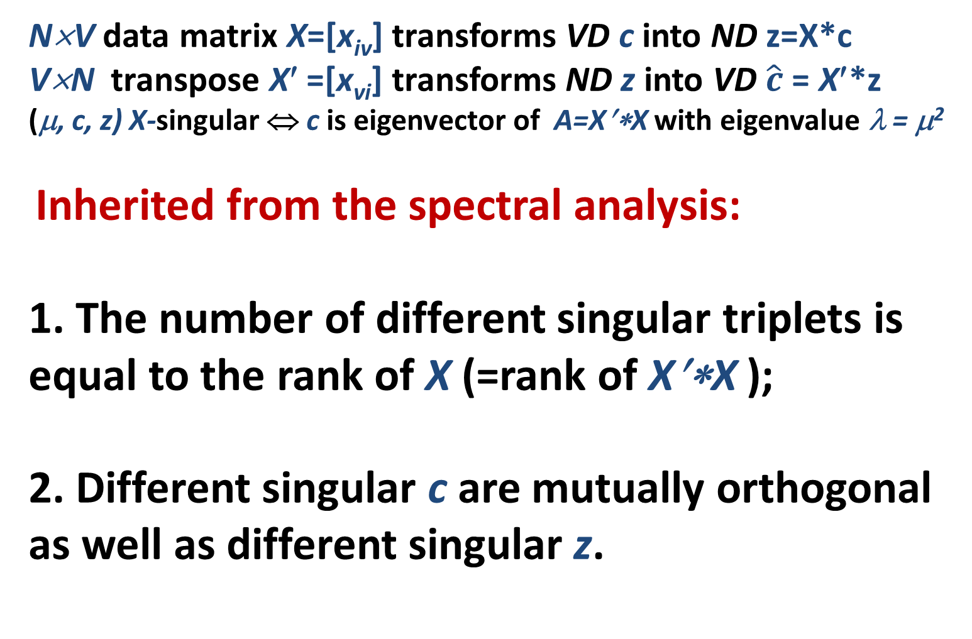
Principal Component Analysis 3: Singular value decomposition, 3 Singular triplets
N×V data matrix X=[x_{iv}] transforms VD c into ND z=X*c
V×N transpose X′ =[x_{vi}] transforms ND z into VD $\hat{c}$= X′*z
(μ, c, z) X-singular ⇔ c is eigenvector of A=X′∗X with eigenvalue λ = μ²
Inherited from the spectral analysis:
1. The number of different singular triplets is equal to the rank of X (=rank of X′∗X );
2. Different singular c are mutually orthogonal as well as different singular z.

Slide 32
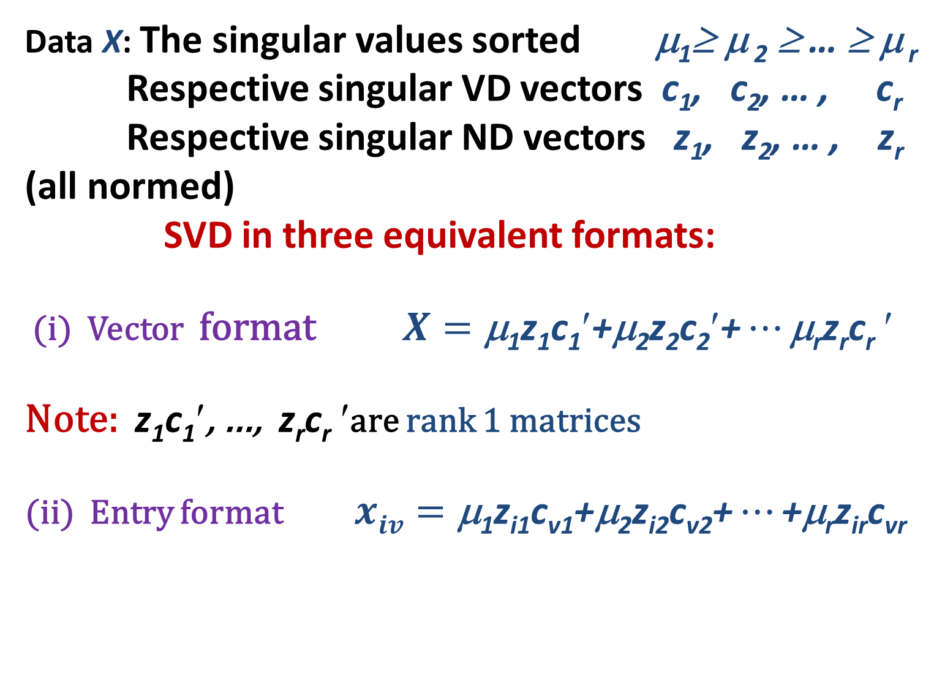
Principal Component Analysis 3: Singular value decomposition, 1 SVD
Data X: The singular values sorted μ₁≥ μ ₂ ≥ … ≥ μ _{r}
Respective singular VD vectors c₁, c₂, … , c_{r}
Respective singular ND vectors z₁, z₂, … , z_{r}
(all normed)
SVD in three equivalent formats:
(i) Vector format $X=\text{μ}\text{1}\text{z}\text{1}\text{c}\text{1}′\text{+}\text{μ}\text{2}\text{z}\text{2}\text{c}\text{2}′\text{+}…\text{μ}\text{r}\text{z}\text{r}\text{c}\text{r}$ $$
Note: $\text{z}\text{1}\text{c}\text{1}′$, …, $\text{z}\text{r}\text{c}\text{r}$ $$are rank 1 matrices
(ii) Entry format $xiv=\text{μ}\text{1}\text{z}\text{i}\text{1}\text{c}\text{v}\text{1+μ2}\text{z}\text{i}\text{2}\text{c}\text{v}\text{2+}…\text{+μ}\text{r}\text{z}\text{ir}\text{c}\text{vr}$

Slide 33
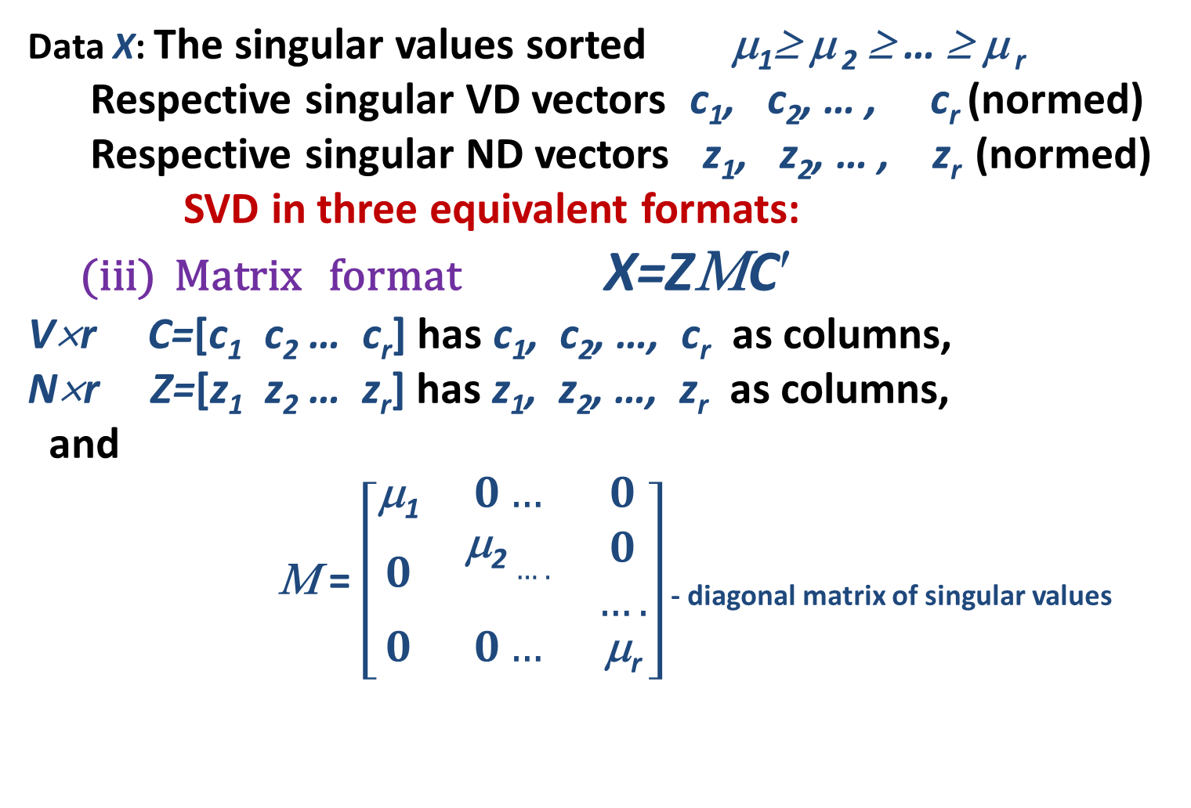
Principal Component Analysis 3: Singular value decomposition, 2 SVD
Data X: The singular values sorted μ₁≥ μ ₂ ≥ … ≥ μ _{r}
Respective singular VD vectors c₁, c₂, … , c_{r} (normed)
Respective singular ND vectors z₁, z₂, … , z_{r} (normed)
SVD in three equivalent formats:
(iii) Matrix format X=ZΜC$$
V×r C=[c₁ c₂ … c_{r}] has c₁, c₂, …, c_{r} as columns,
N×r Z=[z₁ z₂ … z_{r}] has z₁, z₂, …, z_{r} as columns,
and
Μ = $\left[\begin{aligned}\begin{matrix}\text{}\text{1} & 0… & 0 \\ 0 & \begin{aligned}\text{}\text{2}…. \\ \end{aligned} & \begin{aligned}0 \\ ….\end{aligned} \\ 0 & 0… & \text{μ}\text{r}\end{matrix} \\ \end{aligned}\right]$ - diagonal matrix of singular values

Slide 34
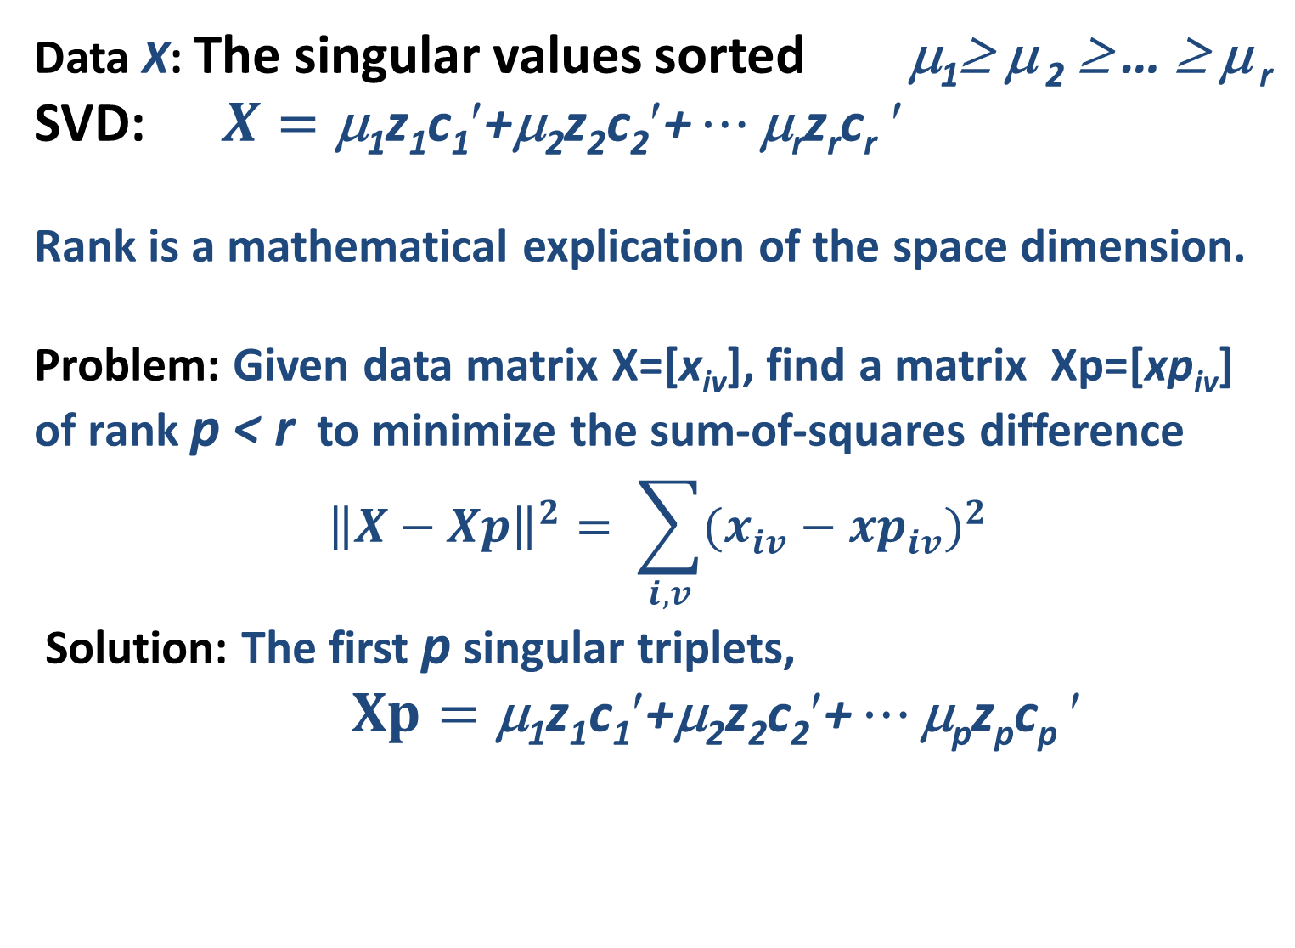
Principal Component Analysis 3: Singular value decomposition: Approximation 1
Data X: The singular values sorted μ₁≥ μ ₂ ≥ … ≥ μ _{r}
SVD: $X=\text{μ}\text{1}\text{z}\text{1}\text{c}\text{1}′\text{+}\text{μ}\text{2}\text{z}\text{2}\text{c}\text{2}′\text{+}…\text{μ}\text{r}\text{z}\text{r}\text{c}\text{r}$ $$
Rank is a mathematical explication of the space dimension.
Problem: Given data matrix X=[x_{iv}], find a matrix Xp=[xp_{iv}] of rank p < r to minimize the sum-of-squares difference
$${\left\|X−Xp\right\|}^{2}= \sum_{i, v}{{(x_{iv}^{}−{xp}_{iv}^{})}^{2}}$$
Solution: The first p singular triplets,
$Xp=\text{μ}\text{1}\text{z}\text{1}\text{c}\text{1}′\text{+μ}\text{2}\text{z}\text{2}\text{c}\text{2}′\text{+}…\text{μ}\text{p}\text{z}\text{p}\text{c}\text{p}$ $$

Slide 35
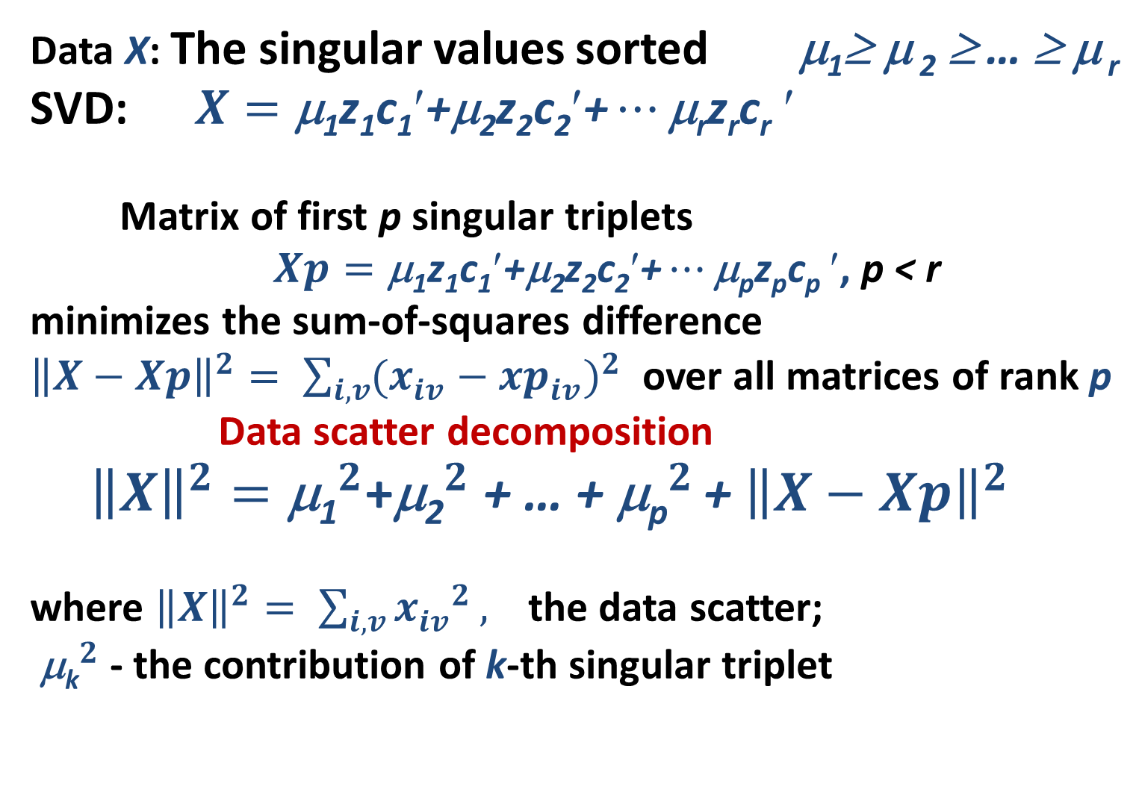
Principal Component Analysis 3: Singular value decomposition: Approximation 2
Data X: The singular values sorted μ₁≥ μ ₂ ≥ … ≥ μ _{r}
SVD: $X=\text{μ}\text{1}\text{z}\text{1}\text{c}\text{1}′\text{+}\text{μ}\text{2}\text{z}\text{2}\text{c}\text{2}′\text{+}…\text{μ}\text{r}\text{z}\text{r}\text{c}\text{r}$ $$
Matrix of first p singular triplets
$Xp=\text{μ}\text{1}\text{z}\text{1}\text{c}\text{1}′\text{+μ}\text{2}\text{z}\text{2}\text{c}\text{2}′\text{+}…\text{μ}\text{p}\text{z}\text{p}\text{c}\text{p}$ $$, p < r
minimizes the sum-of-squares difference
${\left\|X−Xp\right\|}^{2}= \sum_{i, v}{{(x_{iv}^{}−{xp}_{iv}^{})}^{2}}$ over all matrices of rank p
Data scatter decomposition
${\left\|X\right\|}^{2}={\text{μ}\text{1}}^{2}$+${\text{}\text{2}}^{2}$ + … + ${\text{}\text{p}}^{2}$ + ${\left\|X−Xp\right\|}^{2}$
where ${\left\|X\right\|}^{2}= \sum_{i, v}{{x_{iv}^{}}^{2}},$ the data scatter;
${\text{}\text{k}}^{2}$ - the contribution of k-th singular triplet

Slide 36
Data recovery summarization
(b) Correlation problem: target feature scaling predetermines the scale of the output
(a) Summarization outcome much depends on data preprocessing because the recovery extent is measured by the sum of deviations. Deviations change at changing the scale.
E
Encoder

Slide 37
Matrix factorization model, 1
Y=ZC
Y - N×V data matrix (observed, pre-processed)
Z - N×K found matrix, under constraints
C - K×V found matrix, under constraints
PCA
Z: factor scores, C: feature loadings - mutual orthogonality, maximum contribution
K-means
Z: cluster 1/0 membership, mutual orthogonality C: C: cluster centers, no constraints

Slide 38
Matrix factorization model, 2
Ideal: Y=ZC
Y - N×V (observed), Z - N×K, C - K×V (found under constraints)
PCA: Z: factor scores, C: feature loadings - mutual orthogonality, maximum contribution
K-means: Z: cluster 1/0 membership, mutual orthogonality C: C: cluster centers, no constraints
Real: Y=ZC+E
⎥⎪E⎥⎪² = ⎥⎪Y-ZC⎥⎪² ⇒ min _{Z,c}

